Slide 1
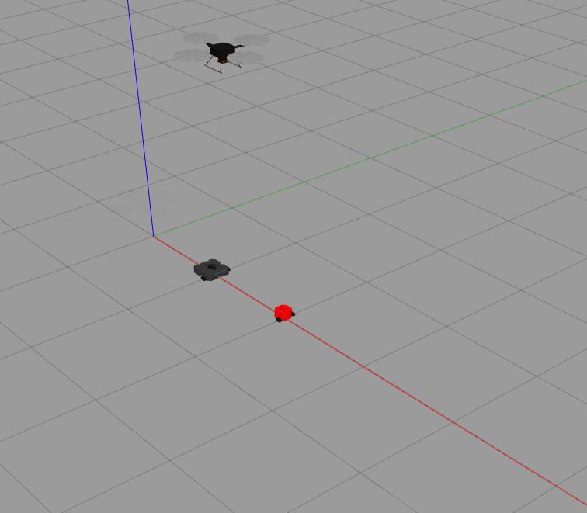

Slide 2


Slide 3



Slide 4















$$A(x_{1},y_{1},z_{1})$$
$$\overset{⃑}{AB}$$
$$\overset{⃑}{AC}$$
$$α$$
$$\overline{AB}$$
$$\overline{AC}$$
$$β$$
$$\overset{⃑}{BA}$$
$$\overset{⃑}{CA}$$
$$γ$$
$$\overset{⃑}{BC}$$
$$B(x_{2},y_{2},z_{2})$$
$$\overline{BC}$$
$$C(x_{3},y_{3},z_{3})$$
$$\overset{⃑}{CB}$$

Slide 5
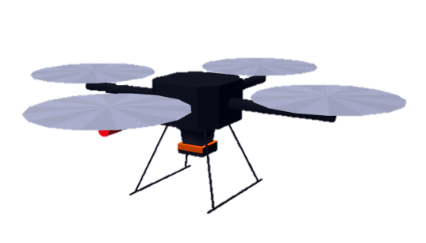

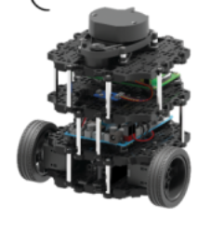

Slide 6
